Slide 1
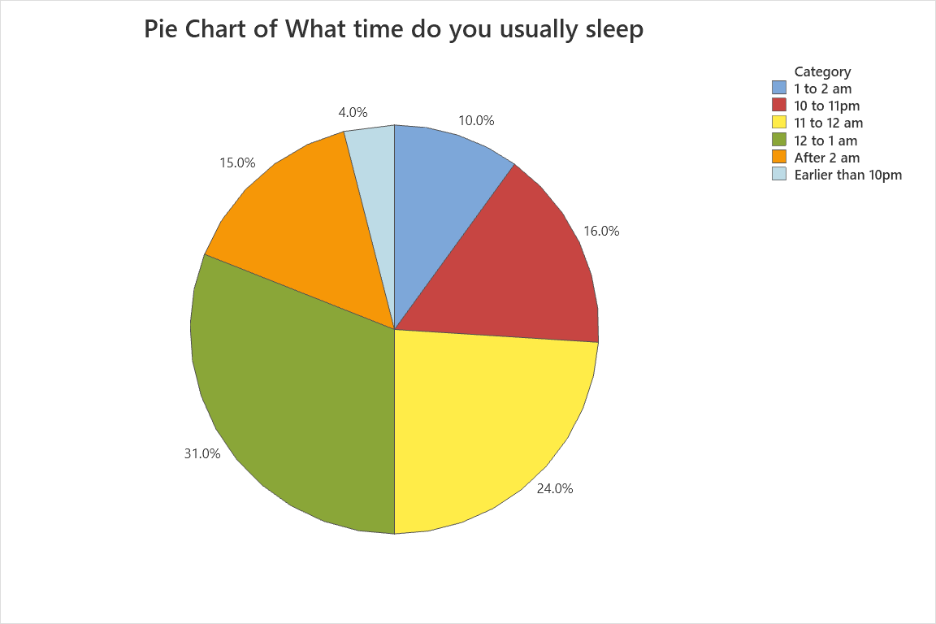
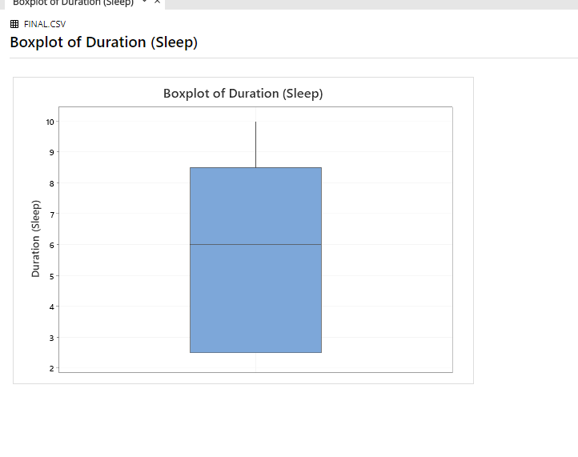
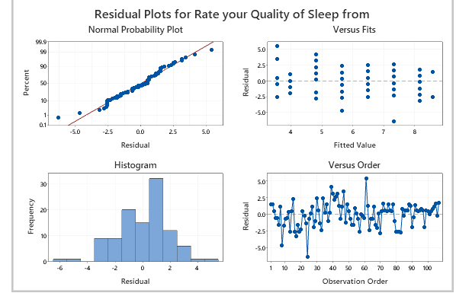
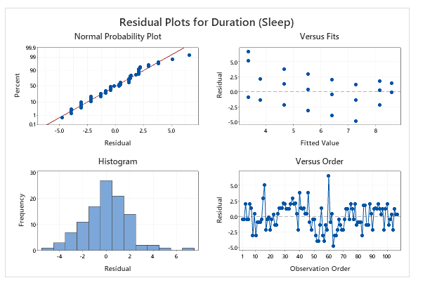
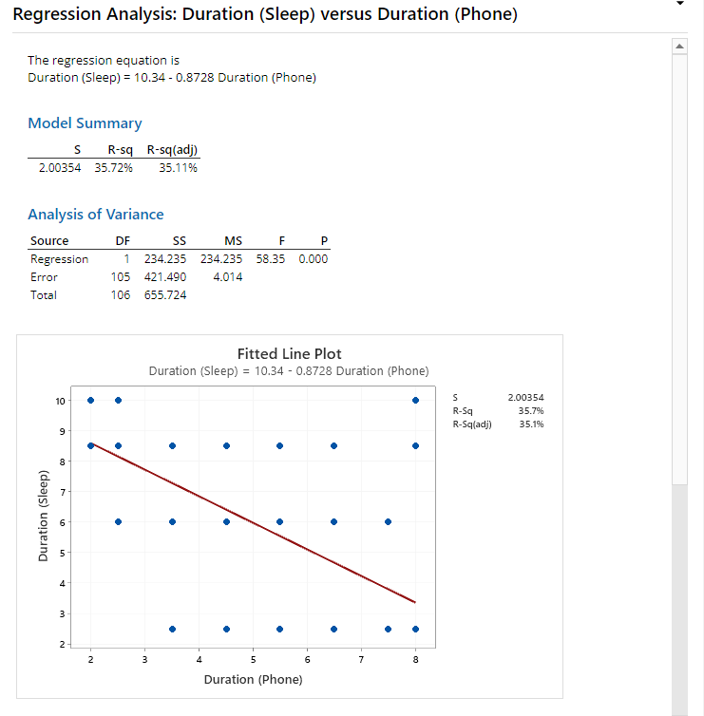
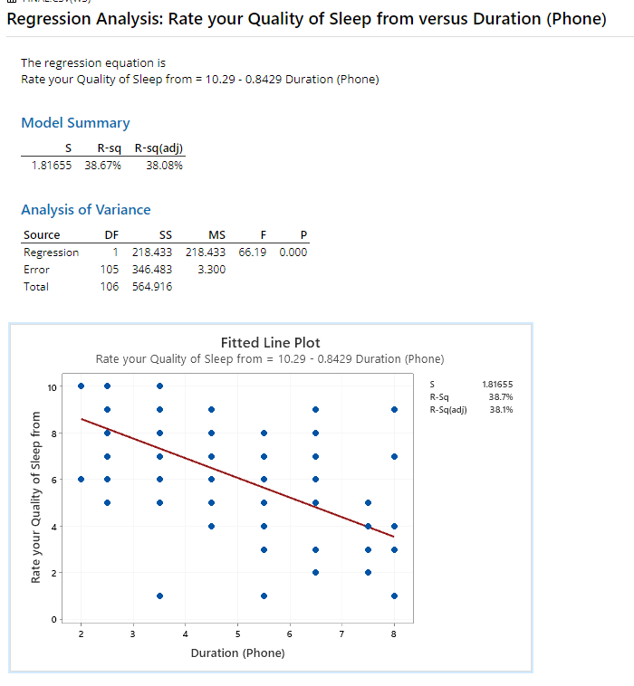
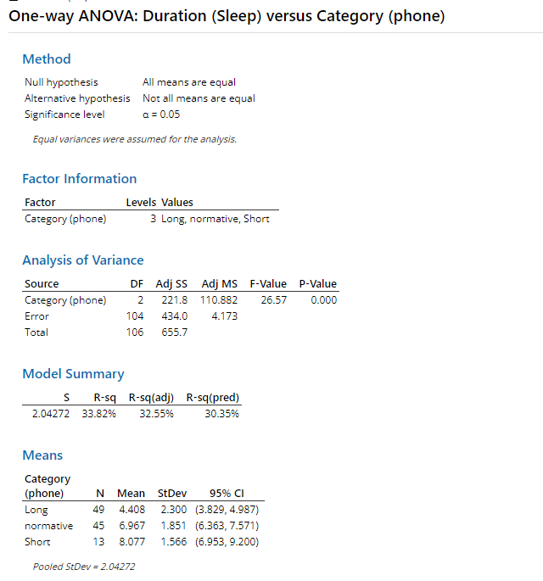
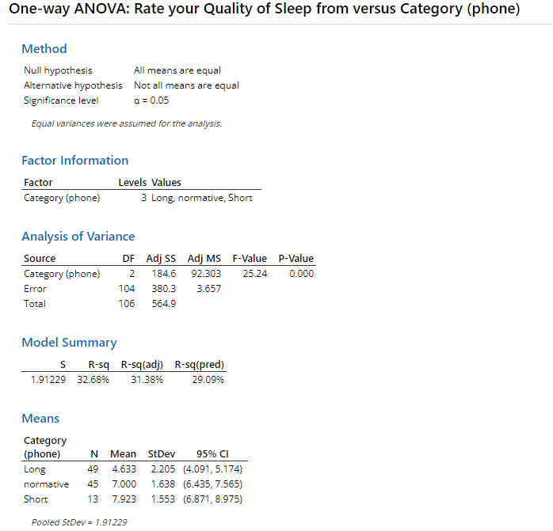
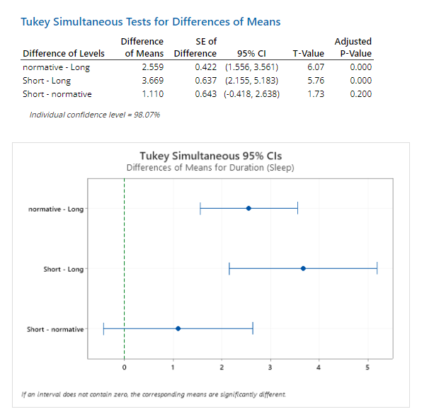
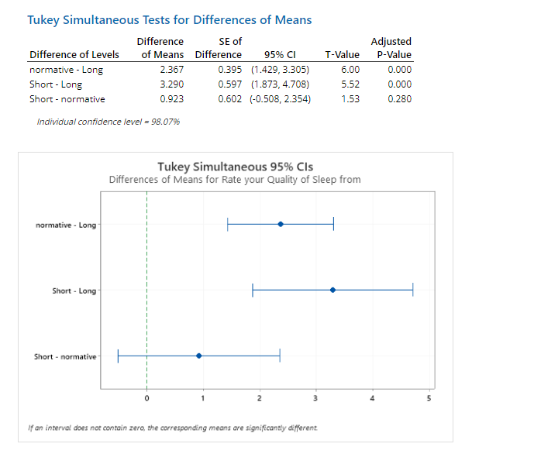
Does the time spent on phone affect the students sleeping schedule?
Kayven chieng Yan heng, Goh Rui Zhuo, Toh Kien Yu, Wang ZiXin
Background Info
My team is interested in studying the relationship between the time spent on phone and students’ sleeping schedule. Technology is the future and we are curious to find out how our screen time affect our quality of sleep. According to experts, quality sleep is very important to our physical and mental health. Insufficient sleep raises a person's risk of significant medical disorders like obesity and diabetes, according to numerous of studies. Lack of adequate sleep over time has also been associated with a shortened lifespan (Dr Ann E. Rogers).
Therefore, our team’s stance of going into this study is that the time spent on phone will affect student’s sleeping schedule.
Context
Q1. What are internet habits
How much screen time does students` racked up each day
Q2. What are student’s sleeping schedule
We defined it as the time when they sleep, the duration of their sleep and the quality of theirs sleep
Q3. Students
We define students as people aged between 14 and 22
Collect Data (Survey)
We collect data using a google form that we circulated around our friends, family and classmate. Upon collecting 120 samples, we filtered to only have results from students which resulted in 100 responses As we collected the data using a survey online we cannot be completely sure of the sampling method.
However as n=100≥30, so the Central Limit Theorem(CLT) applies.
The data we collected and mainly used were:
Age of student (Quantitative)(Continuous)
Duration of sleep (Qualitative)
When students sleep (Qualitative)
Quality of Sleep (Quantitative) (Discrete)
Time Spent on Phone (Qualitative) (Hours)
For duration of sleep, time spent on phone data are collected as a qualitative data. We later then used python to convert it to a quantitative data in order to analyse the data we collected deeper with the use of Minitab.
Basic Analysis
Pie Chart (Time Usually sleep) The pie chart shows the self-reported sleep times of teenagers in one-hour increments. The largest group (31.0%) reported sleeping from 12pm to 1am, followed by 24.0% who sleep from 11pm to 12am. The least common sleep time is earlier than 10pm, accounting for only 4.0%. |  | Boxplot (Duration of sleep) According to a study by the University of Georgia, on average, college students get a whopping six hours of sleep a night. As seen from the boxplot, it shows that students typically sleeps for six hours each night. even to the point of pupils sleeping for fewer than three hours every night. Lack of sleep can take a toll on your mental health, cause a reduction of cognitive performance and affect your memory capacity. The maximum also shows that some students get more than 10 hours of sleep.
Normality Test
Normality test (Quality of sleep) The data points lies closely to the line which therefore we can conclude that the response variable (Quality of sleep) follows a normal distribution suitable for further Anova test |  | Normality test (Duration of sleep) The data points lies closely to the line which therefore we can conclude that the response variable (Duration of sleep) follows a normal distribution suitable for further Anova test
Regression Analysis
Regression Analysis (Duration of sleep vs Duration on phone) The amount of time spent each day on phone in hours was used as the explanatory variable in a regression analysis, and the duration was used as the response variable. The p-value for both the -test and -test is less than 0.05, which means that the results reject the null hypothesis. The R2 value of 35.72% further suggests that there is linear relationship between the variables. In addition, 35.72% of the variation in the duration of sleep is explained by duration spent on phone The study's findings indicate that time spent on device is moderately correlated with the duration of sleep with an r value of 0.59 |  | Regression Analysis (Quality of sleep vs Duration on phone) The amount of time spent each day on phone in hours was used as the explanatory variable in a regression analysis, and the duration of sleep was used as the response variable. The p-value for both the B-test and is less than 0.05 means that the results reject the null hypothesis. The R2 value of 38.67% further suggests that there is a linear relationship between the variables. In addition, 38.67% of the variation in the quality of sleep is explained by duration spent on phone The study's findings indicate that time spent on device is moderately correlated with the quality of sleep with an r-value of 0.622 (3sf)
ANOVA Test
Anova(duration of sleep vs time spent on phone) An ANOVA test was run, using the factor time spent on the phone and the response variable Quality of sleep. This experiment was designed to find out whether sleep duration had an impact on time spent on the phone. The p-value of 0.000 (less than = 0.05) indicates that the null hypothesis is rejected, thus the results would indicate a relationship between the two variables. In addition, 36.08% of the variation in the duration of sleep can be explained by the phone usage Thus, it can be said that duration of sleep. is influenced by variable time spent on the phone |  | Anova(quality of sleep vs time spent on phone) An ANOVA test was run, using the factor time spent on the phone and the response variable Quality of sleep. This experiment was designed to find out whether sleep duration had an impact on time spent on the phone. The p-value of 0.000 (less than = 0.05) indicates that the null hypothesis is rejected, thus the results would indicate a relationship between the two variables if it were true. Thus, it can be said that Quality of sleep. is influenced by variable time spent on the phone
Turkey Pairwise test
Turkey Pairwise test (duration of sleep vs time spent on phone) t-test statistic Test statistic for normative – Long is 6.07 Test statistic for short-Long is 5.76 Test statistic for short-normative is 1.73 P-values P-value for normative – Long is 0 P-value for short-Long is 0 P-value for short-normative is 0 Normative – Long: Point estimate is 2.559. 95% confidence interval is (1.556,3.561) which does not include 0. There is a difference in mean duration of sleep between long usage and normal usage Short – Long: Point estimate is 3.669. 95% confidence interval is (2.155,5.183) which does not include 0. There is a difference in mean duration of sleep between long usage and normal usage Normative – Long: Point estimate is -1.922. 95% confidence interval is (-0.418, 2.638) which does include 0. There is no difference in mean duration of sleep between long usage and normal usage Mean duration of sleep for two of the three groups is significantly different |  | Turkey Pairwise test (duration of sleep vs time spent on phone) 1. t-test statistic I. Test statistic for normative – Long is 6 II. Test statistic for short-Long is 5.52 III. Test statistic for short-normative is 1.53 2. P-values I.P-value for normative – Long is 0 II. Test statistic for short-Long is 0 III. Test statistic for short-normative 0 Normative – Long: Point estimate is 2.367. 95% confidence interval is (1.429,3.305) which does not include 0. There is a difference in mean quality of sleep between long usage and normal usage Short – Long: Point estimate is 3.290. 95% confidence interval is (1.873,4.708) which does not include 0. There is a difference in mean quality of sleep between long usage and normal usage Short – Normative: Point estimate is 0.923. 95% confidence interval is (-0.508, 2.354) which includes 0. There is a no difference in mean quality of sleep between long usage and normal usage
Conclusion Overall, our test showed that a teenager’s screen time does affect their sleeping schedule. This is shocking as contrary to a Straits Times article, The study also confirmed what many parents of a sleepy teen have experienced already - using an electronic device in the hour before bedtime badly affects both onset of sleep and its duration, as expected, there is a correlation.In addition, from another study,The mean duration of sleep at night was 2.3+1.1 hours. A total of 77.5% had sleep problems by ESS and 45% of these had poor sleep quality by PSQI. There were 63 cases (70.8%) having smartphone overuse more than 1 hour during bedtime. Consequent napping in the classroom was found as high as 43.6% (range 0-90) and was associated with smartphone overuse during bedtime significantly (p=0.004). No other student characteristics, daily life behaviours, and classroom environments were associated with napping (Table 1). | References https://medicine.nus.edu.sg/taps/issues/effect-of-smartphone-overuse-on-sleep-problems-in-medical-stude nts/ https://www.straitstimes.com/lifestyle/doctors-confirm-staring-at-screens-especially-before-bedtime-affects-t eens-sleep https://www.sutterhealth.org/health/sleep/screens-and-your-sleep-the-impact-of-nighttime-use#:~:text=Studies%20show%20two%20or%20more,other%20type%20of%20relaxing%20activity.

